Slide 1
Business
Analytics
sudheer mamillapally

Slide 2
Agenda
What is Power BI?
Components
Architecture
Product Portfolio
Life Hack: Small guide to install Pro
Desktop Features: Get, Analyze, Visualize, Publish
Power BI Services
Integration with various Apps
Power Query Editor: The heart of Power BI
Understanding on DAX
Live connectivity & datasources
On-premises data gateway
Dashboard Implementation

Slide 3

Power BI
Power BI is business analytics solution that lets you visualize the data and share the insights to the concern stakeholders and the business owners.
Power BI Components:
Power BI Desktop
Power BI service (SaaS –Software as a Service)
Power BI Mobile Apps
Power BI begins by connecting to data sources and building a report in Power BI Desktop. You then publish that report from Power BI Desktop to the Power BI service, and share it so end users in the Power BI Service and Mobile Devices can view and interact with the report. This workflow is common and shows how the three main Power BI elements complement one another.

Slide 4






Power BI Architecture
Web
Out of the box SaaS content packs
Real time dashboards & interactive reports
Natural Language query
Custom visualizations
Native Office 365 integration
Mobile
Cloud data
Excel
On-premises
Cortana

Slide 5




Power BI Product Portfolio
Author Share & Collaborate Large scale deployments Share & Collaborate App dev
Power BI
Desktop
Power BI
Service
Power BI
Premium
Power BI
Report Server
Power BI
Embedded
Free data analysis
and reporting authoring tool
Cloud based modern business analytics solution
Dedicated capacity for increased performance
On-premises report server
Visual analytics embedded in your applications

Slide 6

Power BI Pro - Life Hack
Download Power BI Desktop : https://powerbi.microsoft.com/en-us/downloads/
Life Hack
How to sign up for Power BI without a work email
Incognito:
Log in to office.com → Enterprise→ Plans & Pricing → E3 or E5 account
Try for free

Slide 7


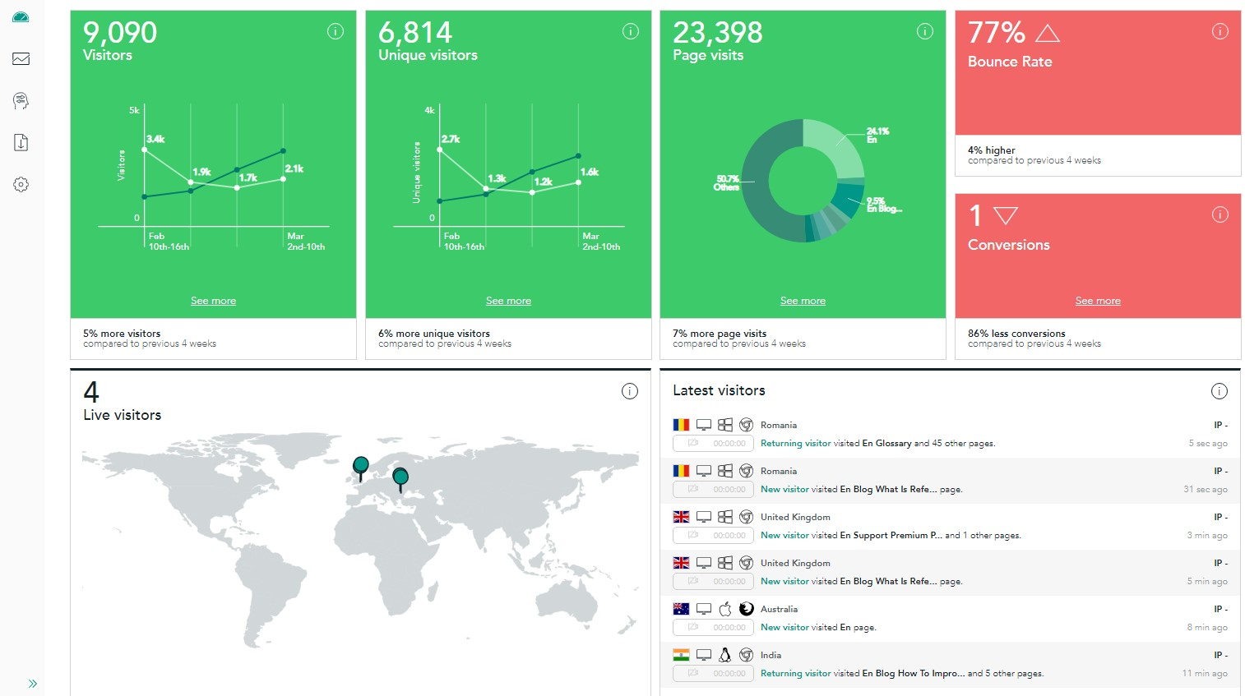



Power BI Desktop
Get Data
Easily connect, clean, and mashup data
Analyze
Build powerful models and flexible measures
Visualize
Create stunning interactive reports
Publish
Share insights with others
Collaborate
Empower your organization with self-service analytics

Slide 8
Power BI Desktop
Get Data
Easily connect, clean, and mashup data
Connect to 80+ data sources, both on-premises and cloud
Shape, transform, and clean data for analysis
Live connectivity to on-premises and cloud data sources
Extend with custom data connectors for any data source
Prep your data using the familiar Power Query experience on the web
Get started quickly with a common data model
Extend self-service prep to Azure Data Lake Storage

Slide 9
Power BI Desktop
Analyze
Build powerful models and flexible measures
Automatically created model when connecting to data
High performance, in-memory engine
Point and click analysis with Quick measures, clustering & binning
Create powerful measures with familiar DAX (Data Analysis Expressions) formulas

Slide 10
Power BI Desktop
Visualize
Create stunning interactive reports
Author reports using 150+ visuals via a drag-drop canvas
Explore data across multiple interactive visualizations
Provide insights in the context of the business with Customer Visuals
Visualize data story with bookmarks and customer navigation

Slide 11
Power BI Desktop
Publish
Share insights with others
Publish directly to the cloud or on-premises
Automatic data refresh, so the reports are always up to date
Package your reports in apps for easy consumption and control
Manage analytics content with admin and governance tools

Slide 12
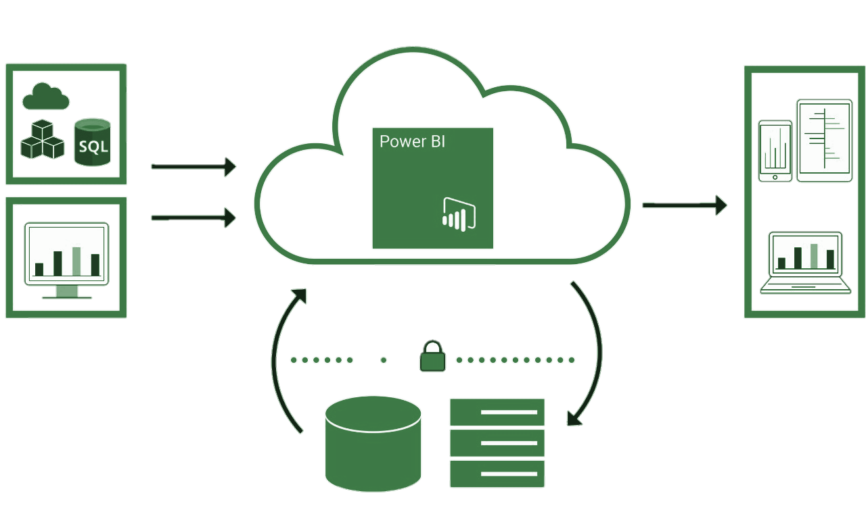
Power BI Services
Secure, live connection to the data sources
on-premises and in the cloud
Keep data anywhere
Secure live connections to the data
Keep data fresh
Power BI Services
Data Sources
Connect
Access
Publish
Power BI Gateways
Power BI
Desktop
Your Organization’s Data

Slide 13





Integration with Power BI
Deliver insights through other services
Collaborate and share insights with teams in your organization using existing services.
Fully interactive reports integrated into the service

Slide 14
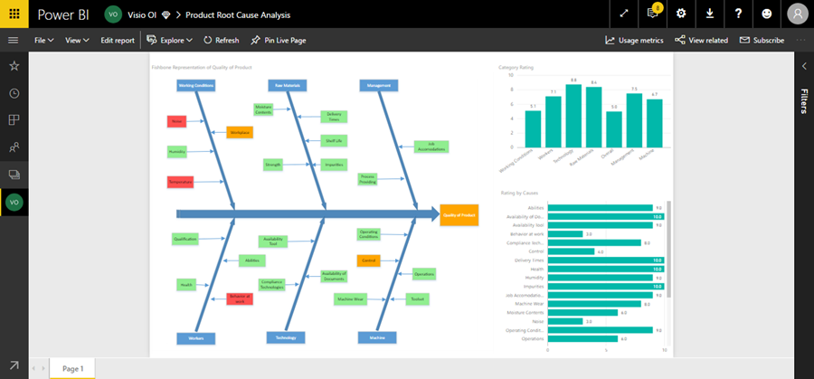
Excel & Power BI
Easily aggregate objects from multiple Excel files on the same dashboard in Power BI
Analyze in Excel
Use Excel to view and interact with a dataset you have in Power BI
Import Excel data into Power BI
Connect to the data in your workbook so you can create Power BI report and dashboards
Upload your Excel file to Power BI
Bring your Excel file into Power BI to view and interact with it just as you would in Excel Online. Pin ranges to Dashboards

Slide 15
Power Query
Editor

Slide 16
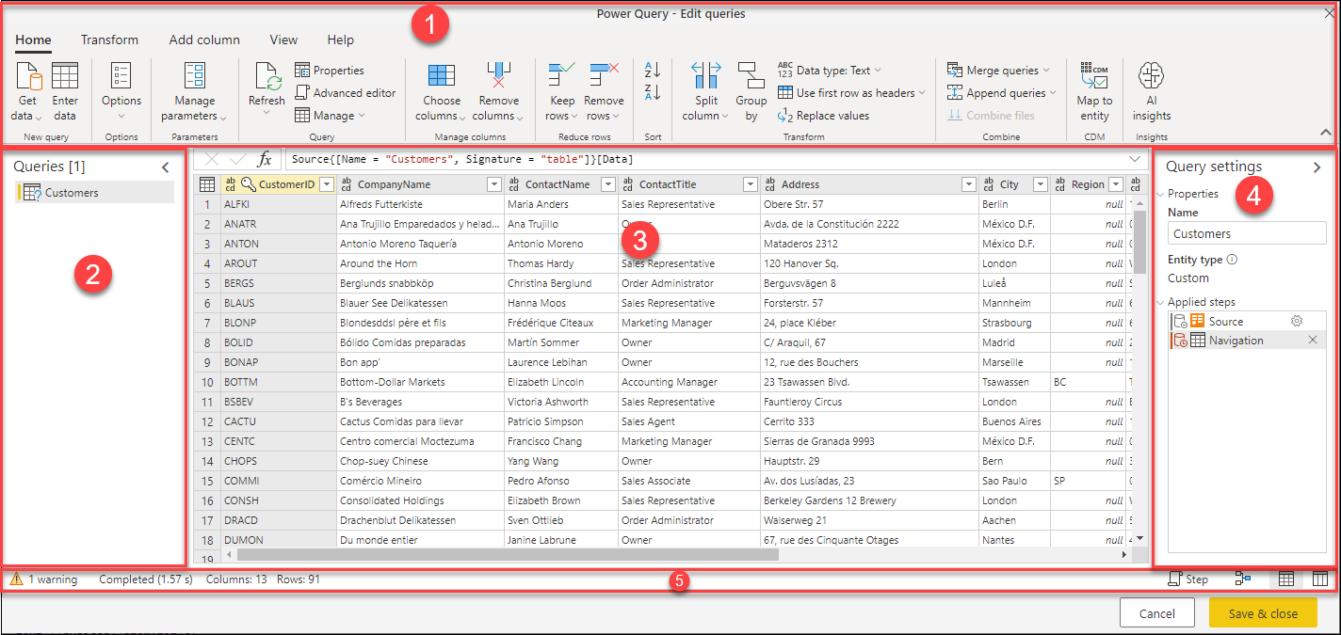
User Experience
The Power Query editor represents the Power Query user interface, where you can add or modify queries, manage queries by grouping or adding descriptions to query steps, or visualize your queries and their structure with different views. The Power Query user interface has five distinct components.

Slide 17
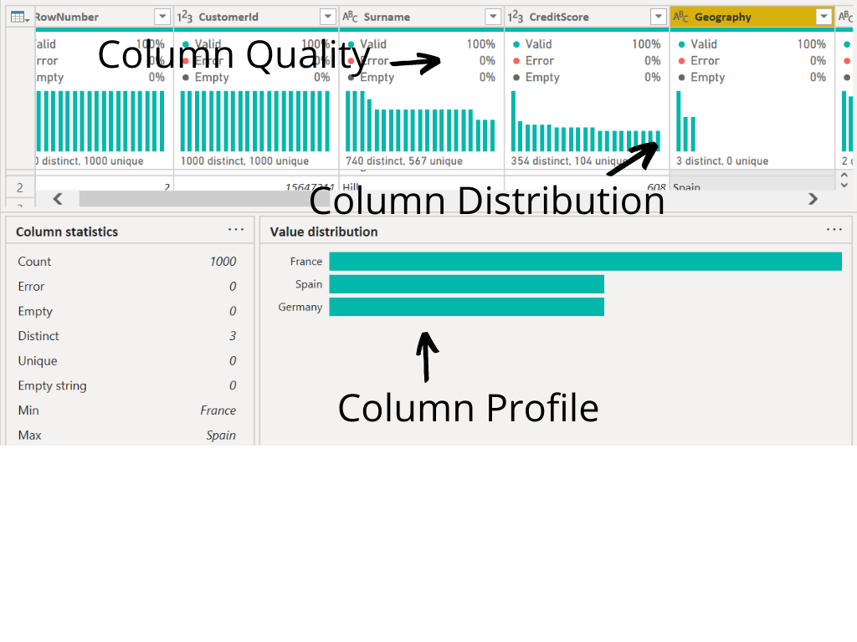
Data Profiling Tools
The data profiling tools provide new and intuitive ways to clean, transform, and understand data in Power Query Editor. They include:
Column quality
Column distribution
Column profile

Slide 18
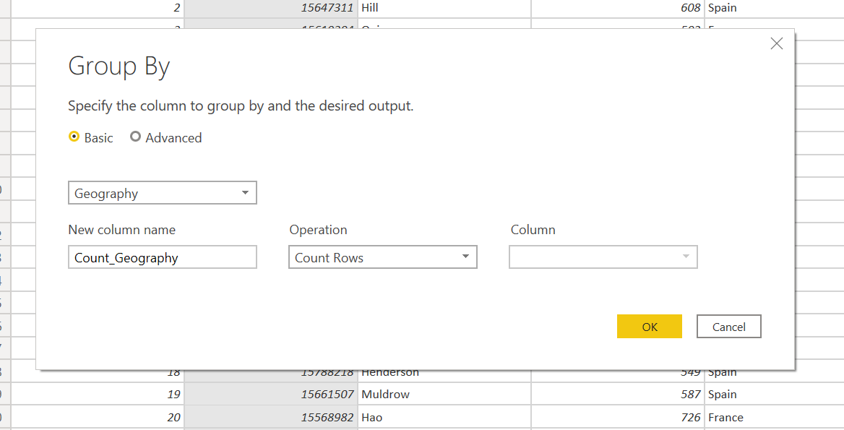
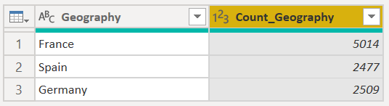
Group By Dialog
In the Group by dialog, set the Group by operation to group by the Geography and count the number of supplier rows per Geography.

Slide 19
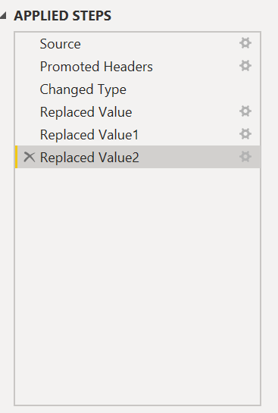
Applied Steps
Any steps performed in Power BI is logged under the Applied Steps, which can be deleted or added anytime during the process

Slide 20
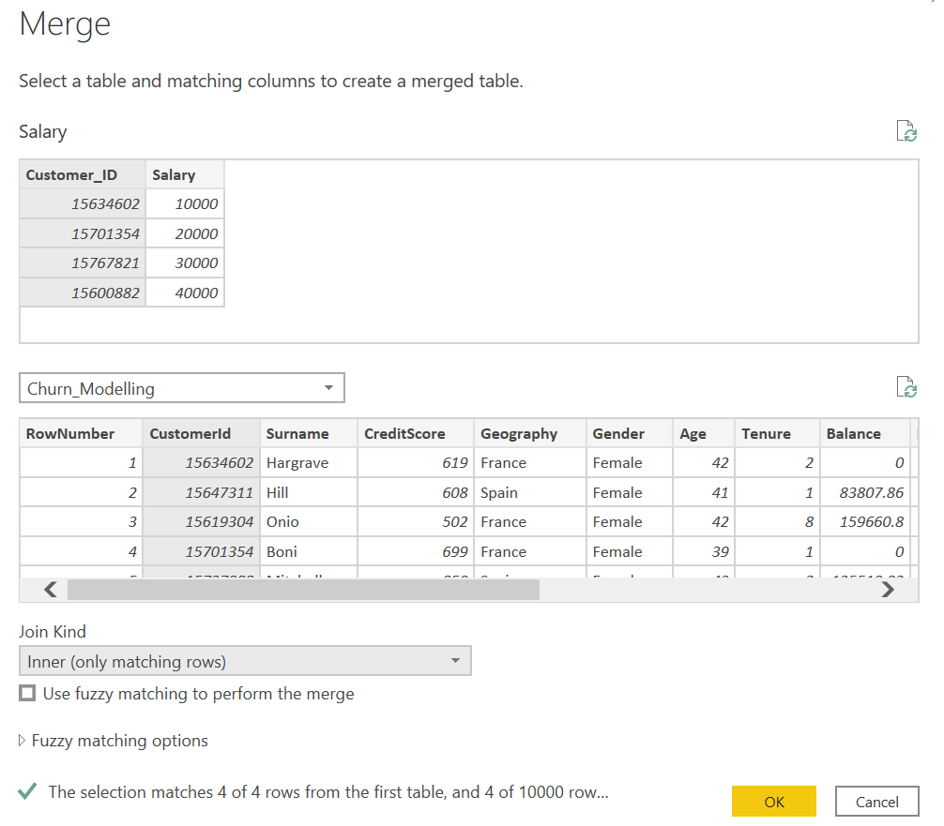
Appending vs Merging
When you have one or more columns that you'd like to add to another query, you merge the queries. When you have additional rows of data that you'd like to add to an existing query, you append the query.

Slide 21
Welcome to
DAX

Slide 22

Power BI - DAX
In order to say that you know DAX, you need:
You need to know these functions
SUM, AVERAGE, MIN, MAX, COUNT, COUNTROWS, CALCULATE, FILTER etc.
Contexts: Row Context & Filter Context
Other things: Formatting, Best practices, X vs non X functions, Time Intelligence Functions

Slide 23
First DAX Expression
DAX: Data Analysis Expression
Two business logics: Measures & Calculated Columns
As per google, Measures and calculated columns both use DAX expressions. The difference is the context of evaluation. A measure is evaluated in the context of the cell evaluated in a report or in a DAX query, whereas a calculated column is computed at the row level within the table it belongs to.

Slide 24
Calculated Columns
Represents a single value per row
Computed at compile time
Results are dynamic, based on filters
This is called the row context
Tenure_Months := Churn[Tenure]*12

Slide 25
Measures
Represents a single value per data model
Computed at run time
Results are dynamic, based on filters
This is called the filter context
Not attached to any specific table
TotalQuantity := SUM(Sales[Quantity])

Slide 26
Implicit Measures
If we use a calculated column as a value/result, it creates an implicit measure.
For example:
If we have columns such as Tenure in years, Monthly average usage, and let say we want to create the overall average usage for that particular customer.
Churn[Tenure_Months] = Churn[Tenure]*12
Total usage for that customer will be,
Churn[Total Usage] = Churn[Tenure_Months] * Churn[Monthly_Average_Usage]
Which means, a change in the primitive column i.e. tenure, will impact the change in the Total Usage column

Slide 27
DAX is good at two things
Aggregations
Filtering
Aggregations:
Agg is combining a group of values into one value.
Examples:
Sum
Average
Min
Max
Distinctcount

Slide 28
Power BI
Let’s do a SUM(Column)
How to check whether it’s correct?
If you are using select SUM(quantity) from tablename;

Slide 29
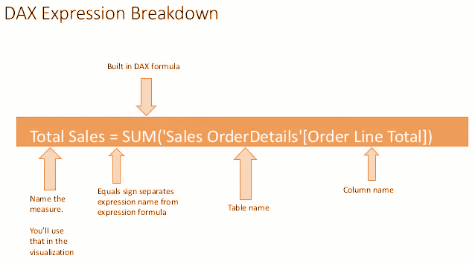
Power BI
DAX Breakdown

Slide 30
Power BI
Easy Peasy
SUM
AVERAGE
MIN
MAX
COUNT
COUNTROWS
DATEDIFF
DATEADD

Slide 31
Power BI
AVERAGE & DATEDIFF
Probation Period = DATEDIFF(column1, column2, DAY)
Average = AVERAGE(column)

Slide 32
Power BI
Calculated Table
Dates = CALENDAR(range)
Creates a dates table with a date per day between the specified range
Also creates a Date Hierarchy

Slide 33
Power BI
Now on to Contexts!!
Two different contexts:
Row context
Filter context

Slide 34
Power BI
We already know how it works!
We've been using it for all our calculated columns so far, let's revisit our first DAX
Tenure in Years = ROUND(Churn_Modelling[Tenure]/12,2)
Notice we expect a value per row in a table
This runs at import and gets stored
Might increase file size

Slide 35
Power BI
Filter Context
Easy to show with measures

Slide 36
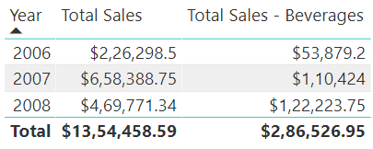
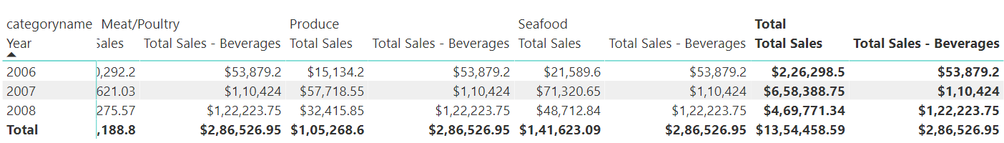
Power BI
CALCULATE: Breaking out of the filter context
Total Sales - Beverages = CALCULATE
(
sum('Sales OrderDetails'[Order Line Total])
, 'Production Categories'[categoryname] = "Beverages"
)

Slide 37
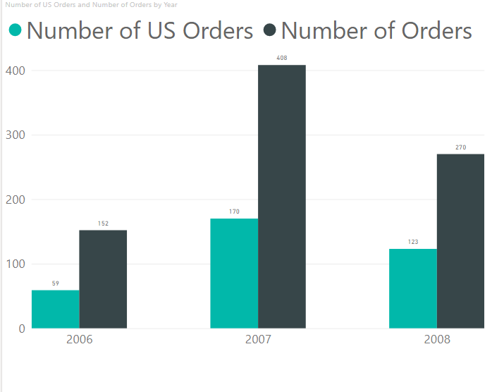
Power BI
Filter
Number of US Orders = CALCULATE
( COUNT
( 'Sales OrderDetails'[orderid])
, FILTER (
'Sales Customers' , 'Sales Customers'[country] = "USA" ))
Number of Orders = COUNT('Sales Orders'[orderid])

Slide 38
Power BI
Variables
VAR myVar=1
Variable
Name
variable value
Data Type
RETURN myVar + 25

Slide 39
Power BI
IF-ELSE & NESTED IF BLOCKS
Similar concepts like other programming languages.
Age_Bins = IF(Churn_Modelling[Age]>=60, "Above 60", "Below 60")

Slide 40
Power BI
Time Intelligence Functions
Time intelligence functions enable you to manipulate data using time periods such as years, quarters, months, and days and creating calculations over those time periods. The most common time periods that we encounter in business scenarios are usually Year-to-Date, Quarter-to-Date, Month-to-Date, Last Year Full Year, and Rolling 12 Months. There are many other time intelligence functions in DAX.

Slide 41
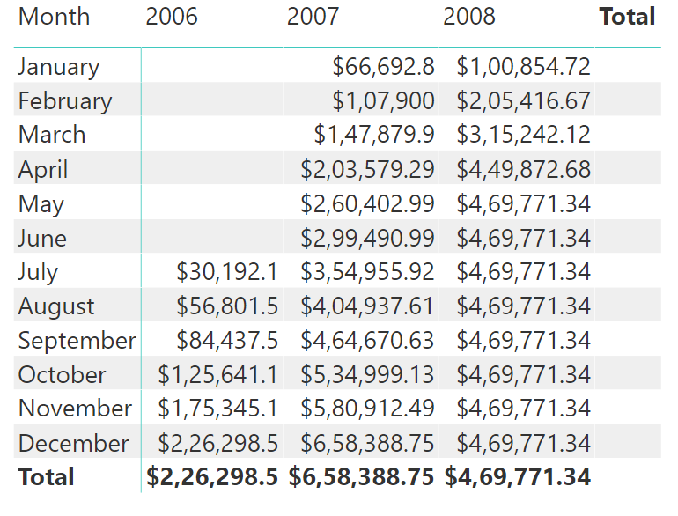
Power BI
Time Intelligence: TOTALYTD
YTD Total Sales = TOTALYTD
(
SUM('Sales OrderDetails'[Order Line Total])
, Dates[Date].[Date]
)

Slide 42
Power BI
How to find the YTD for last year?
How to find the passengers in last year but same month

Slide 43
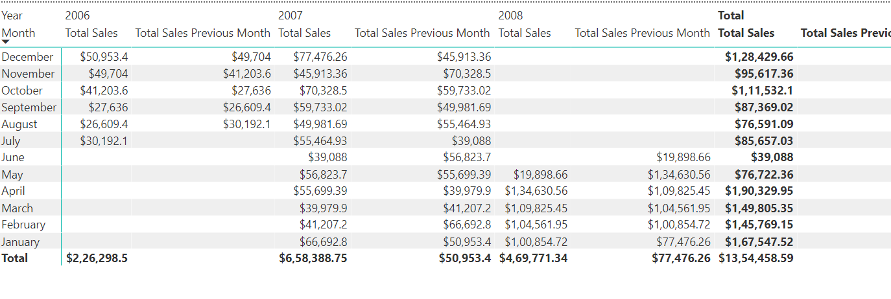
Power BI
Time Intelligence: PREVIOUSMONTH
Total Sales Previous Month = CALCULATE
(
sum('Sales OrderDetails'[Order Line Total])
, PREVIOUSMONTH(Dates[Date])
)

Slide 44
Power BI
X vs nonX functions(SUM vs SUMX)
• SUM is an aggregator function. It works like a measure, calculating based on the current filter context.
SUMX is an in-memory iterator function. It works row by row. SUMX has awareness of rows in a table, hence can reference the intersection of each row with any columns in the table.

Slide 45
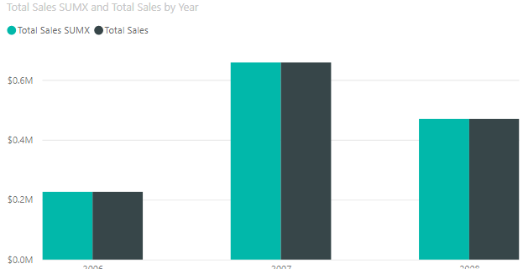
Power BI
SUM VS SUMX: EXAMPLE
Total Sales SUMX = SUMX(
'Sales OrderDetails'
, 'Sales OrderDetails'[qty]
* 'Sales OrderDetails'[unitprice]
)
Total Sales =
sum('Sales OrderDetails'[Order Line Total])

Slide 46
Power BI
AVERAGE, AVERAGEA, AVERAGEX
• AVERAGE → Averages out the data • AVERAGEA → Considers non integer values as null • AVERAGEX → Creates In memory measure
AVERAGEX is also an iterator function. It works row by row. AVERAGEX has awareness of rows in a table, hence can reference the intersection of each row with any columns in the table.

Slide 47
Power BI
Best Practice: Organize your code
Create a separate table for measures
Limit Visuals: As visuals interact with each other, if we have more visuals, it might take a lot of time to refresh. Tool tips & Drill through can be used.
Process as much data as required in the original source
Certified Visuals are recommended
Use a lighter background

Slide 48
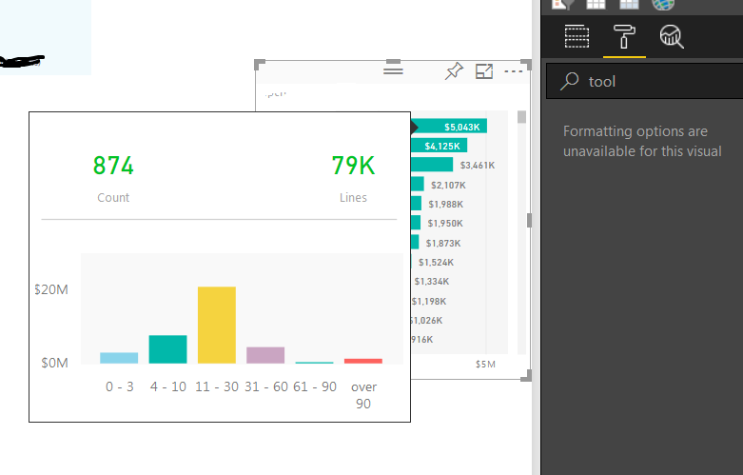
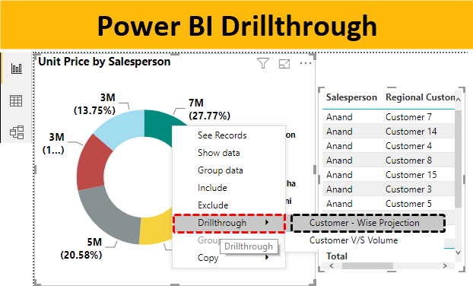
Power BI
Tool tips & Drill Throughs

Slide 49
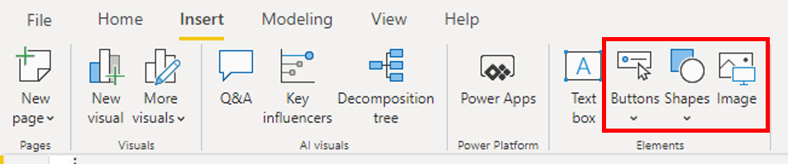
Power BI
Page Navigation

Slide 50
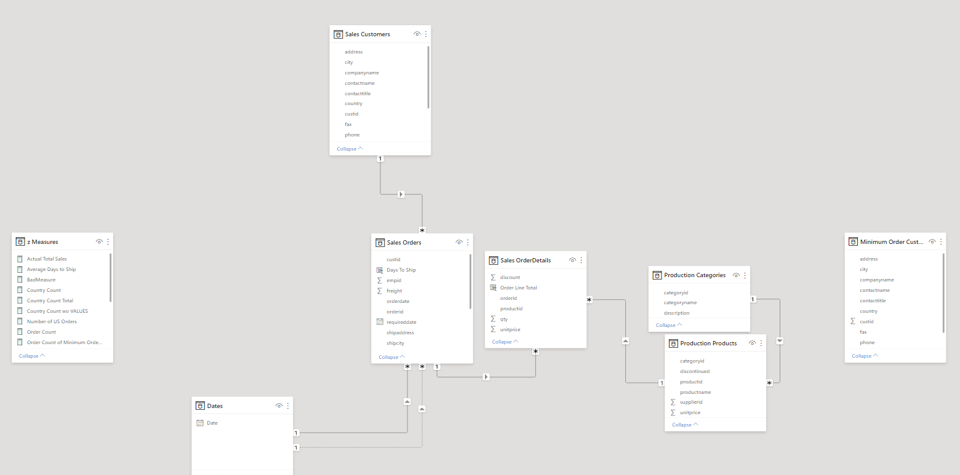
Power BI
RELATIONSHIP

Slide 51
Power BI
Visuals

Slide 52
Building Blocks of Power BI
Visualizations
Datasets
Reports
Dashboards
Tiles

Slide 53
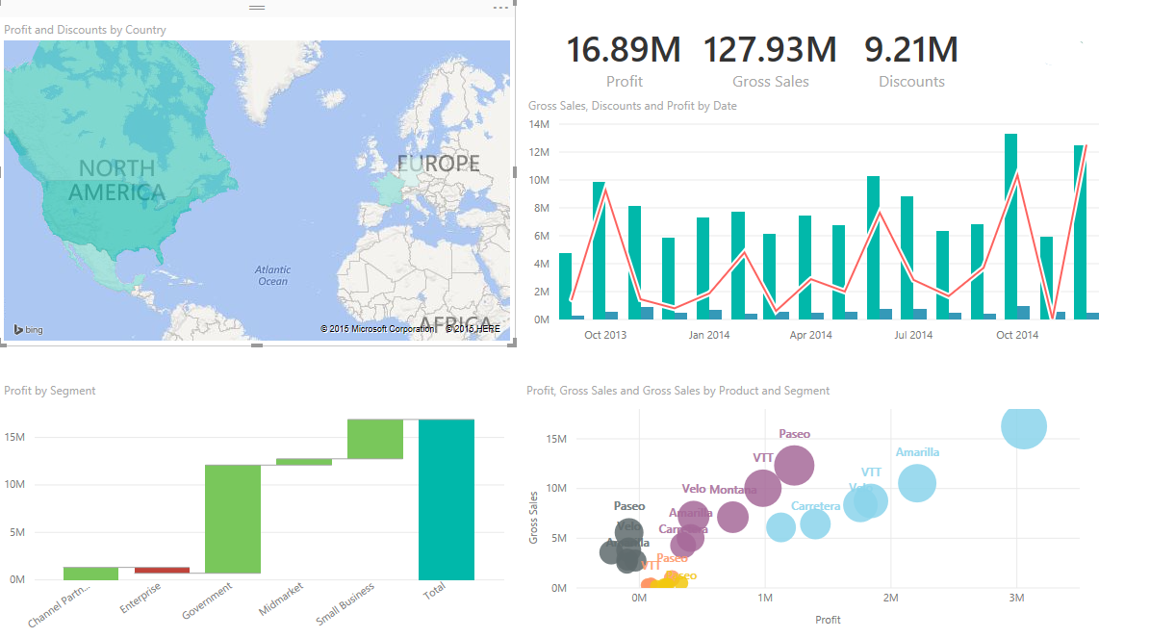
Building Blocks of Power BI
Visualizations
A visual representation of data is called visualization. For example, a chart, or a graph can be used to represent data visually.
Datasets
Reports
Dashboards
Tiles

Slide 54
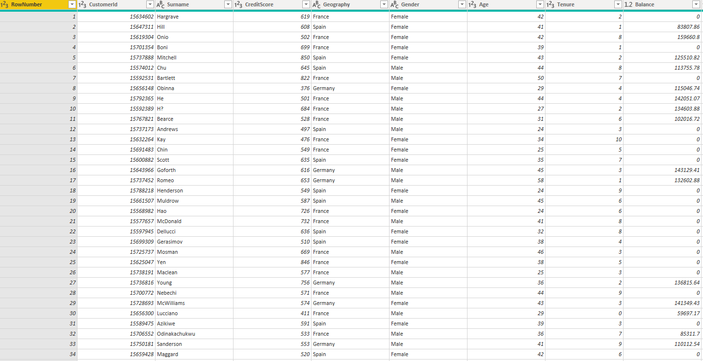
Building Blocks of Power BI
Visualizations
A dataset is a collection of data or information
Datasets
Reports
Dashboards
Tiles

Slide 55
Building Blocks of Power BI
Visualizations
A collection of visualizations that appear together on one or more pages is a report in Power BI. It is a collection if items that have common motive.
Datasets
Reports
Dashboards
Tiles

Slide 56
Building Blocks of Power BI
Visualizations
A Power BI dashboard is a single page interface that uses the most important elements of a report to tell a story.
Datasets
Reports
Dashboards
Tiles

Slide 57
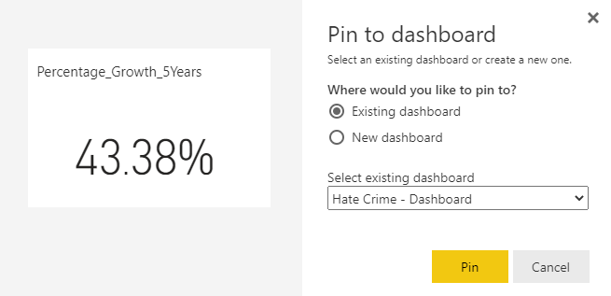
Building Blocks of Power BI
Visualizations
In Power BI, a tile is a single visualization found in a report or on a dashboard
Datasets
Reports
Dashboards
Tiles

Slide 58
Power BI
Charts

Slide 59


Different Charts in Power BI
1
Bar, Column, Line & Area Charts
2
Combination Charts
3
Pie-Charts, Doughnut charts
4
Maps, Funnel Charts
5
Gauge, Cards, Tables & Matrices

Slide 60
Power BI
KPIs

Slide 61
Topics to be covered.
What is KPI ?
When to use KPI ?
What do you require for KPI ?
How to use KPI visualizations ?

Slide 62
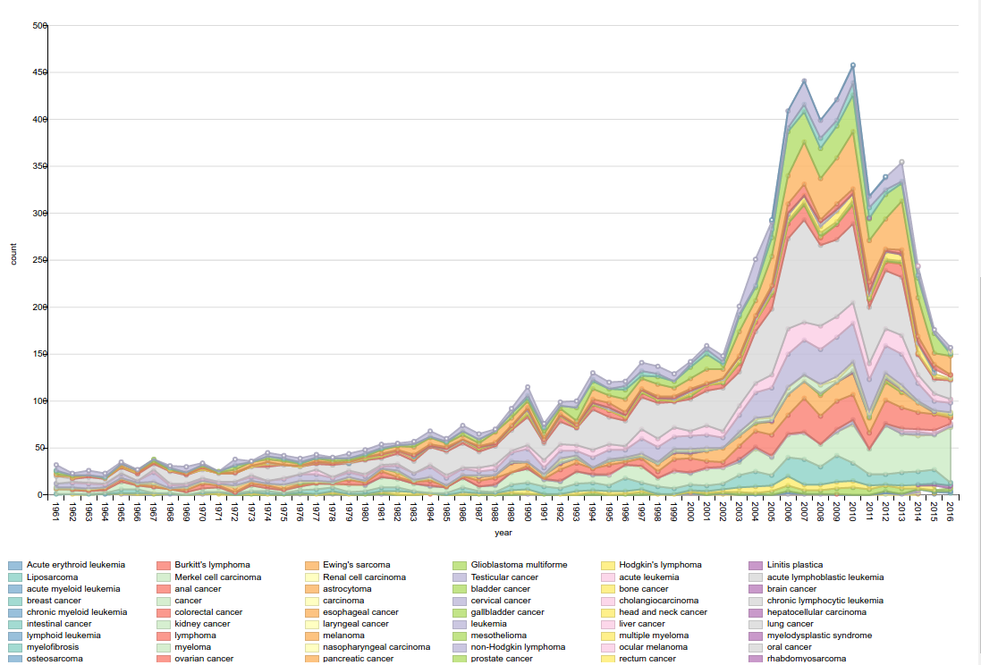
When to use KPI?
A key performance indicator (KPI) is a visual cue that communicates the amount of progress made toward a target.
1
What is KPI ?
2
When to use?
3
Requirements for KPI
4
KPI Visualizations

Slide 63


When to use KPI?
1
TARGET
What is KPI ?
TREND
2
When to use?
3
Requirements for KPI
4
KPI Visualizations

Slide 64
When to use KPI?
BASE MEASURE
1
What is KPI ?
2
When to use?
TARGET MEASURE
3
Requirements for KPI
THRESHOLD
4
KPI Visualizations

Slide 65
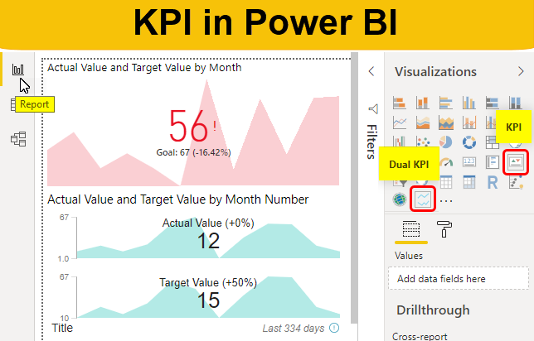
When to use KPI?
1
What is KPI ?
2
When to use?
3
Requirements for KPI
4
KPI Visualizations

Slide 66
Edit
Interactions

Slide 67
Formatting
Options

Slide 68
Administration
Options

Slide 69
Different Roles in Power BI Service
Admin
Member
Contributor
Viewer

Slide 70
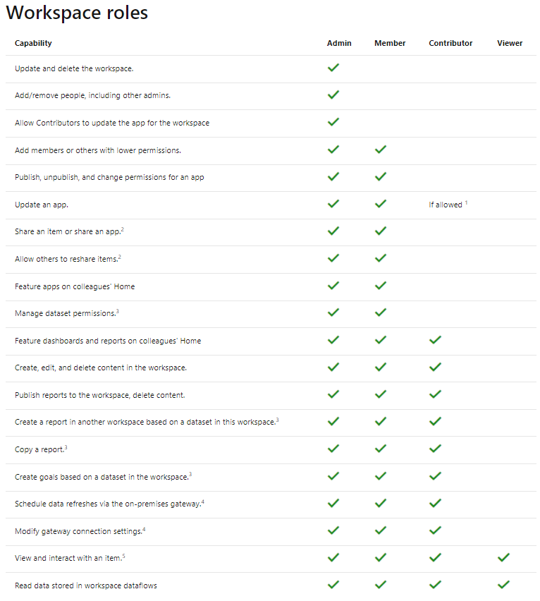
Different Roles in Power BI Service
Link: https://docs.microsoft.com/en-us/power-bi/collaborate-share/service-roles-new-workspaces

Slide 71
Security
in Power BI

Slide 72
Exploratory
Data Analysis

Slide 73




Visualization
Visualisation is the presentation of the data in the graphical or visual form to understand the data more clearly. Visualisation is easy to understand the data.
Easily analyse the data and summarize it.
.
Easily understand the features of the data.
.
Help to find the trend or pattern of the data.
Help to get meaningful insights from the data.

Slide 74
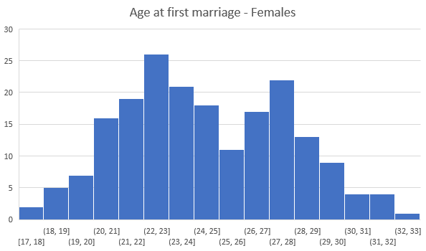
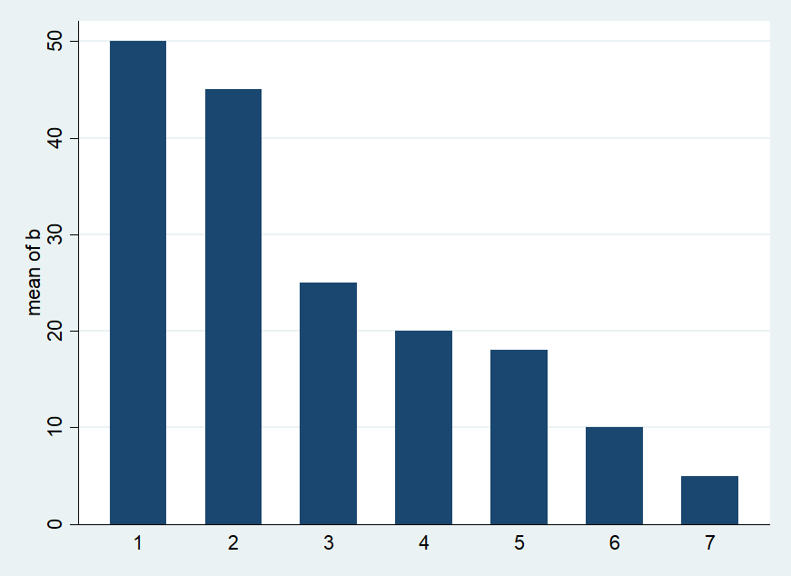
Important Charts for Visualisation
Histogram
Histogram represent the frequency distribution of the data
Bar Chart
Bar graph represent the total observation in the data for a particular category.

Slide 75
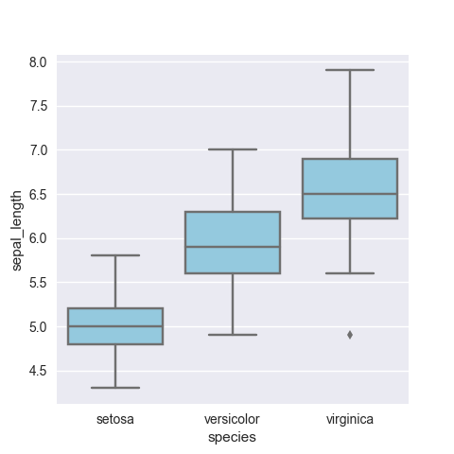
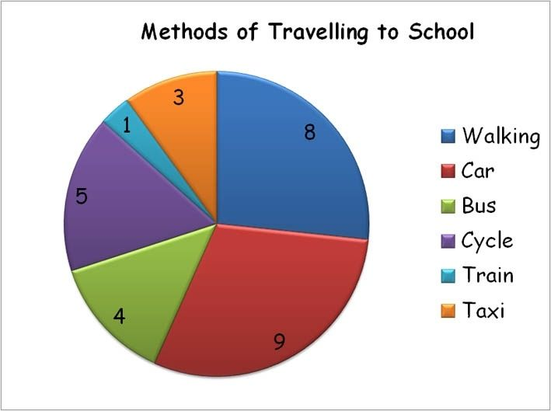
Box Plot
Boxplot display the distribution of the data based on five number summary(minimum, first quartile, median, third quartile, maximum)
Pie Chart
Pie chart represent the percentage of the data by each category.

Slide 76
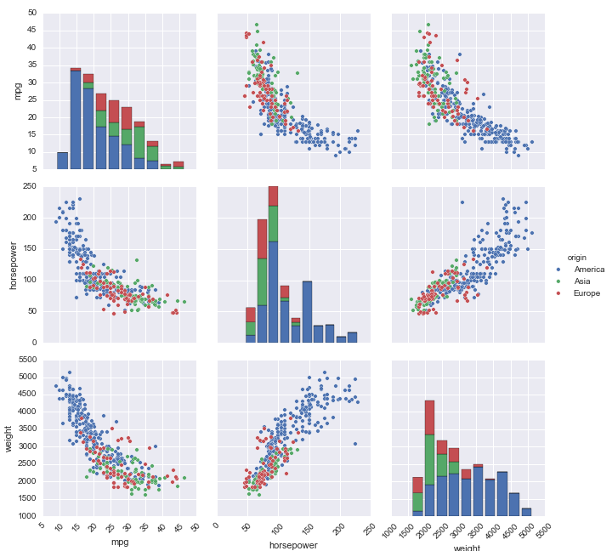
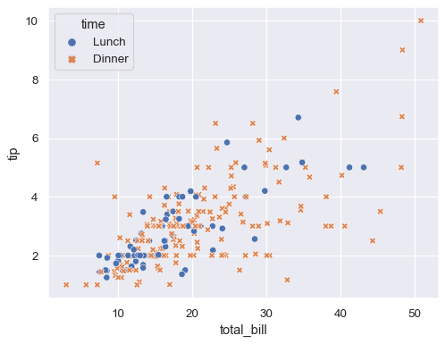
Pair-plot
Pair plot show the bivariate distribution of the datasets. It show the pairwise relationship between the variable
Scatter Plot
Scatter plot represent the relationship between two numerical variable. It show the correlation between two variable.

Slide 77
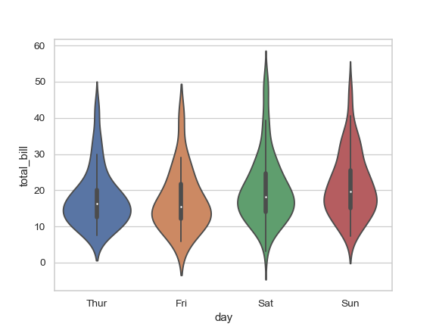
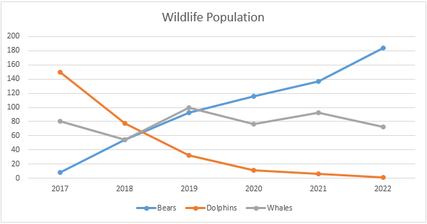
Violin Plot
Violin chart are used to plot numeric data
Line Chart
Line chart are used to track change over line and short period of time. Line chart are used in time series data.

Slide 78

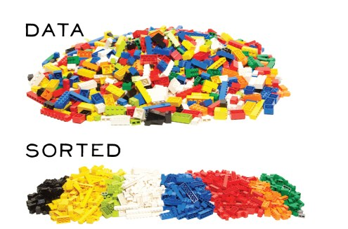

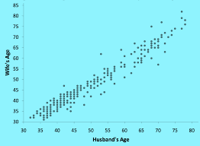

Steps Involved in EDA
01
Data Sourcing
02
Data Cleaning
03
Categorical Data Analysis:
Univariate/Bivariate/Multivariate Analysis with Visualisation
04
Numerical Data Analysis
.
05
Derived Metrics

Slide 79
Handle Missing Value
Delete Rows/Columns
Option A
This method we commonly used to handle missing values. Rows can be deleted if it has insignificant number of missing value Columns can be delete if it has more than 75% of missing value
Option B
Replacing with mean/median/mode
This method can be used on independent variable when it has numerical variables. On categorical feature we apply mode method to fill the missing value.
.
Option C
Algorithm Imputation
Some machine learning algorithm supports to handle missing value in the datasets. Like KNN, Naïve Bayes, Random forest.
.
Option D
Predicting the missing values
Prediction model is one of the advanced method to handle missing values. In this method dataset with no missing value become training set and dataset with missing value become the test set and the missing values is treated as target variable.

Slide 80
Types of Data
Qualitative
Quantitative
A variable which able to describe quality of the population.(Numerical values)
A variable which quantify the population(distinct categories)
Nominal
Ordinal
Discrete
Continuous

Slide 81


Types of Data
Discrete
Nominal
.
It represent qualitative information without order. Value represent a discrete units.
Like Gender: Male/Female ,Eye colour.
It has a discrete value that means it take only counted value not a decimal values. Like count of student in class
Continuous
Ordinal
A number within a range of a value is usually measured, such as height.
.
It represent qualitative information with order. It indicate the measurement classification are different and can be ranked. Lets say Economic status: high/medium/low which can ordered as low,medium,high.

Slide 82

Derived Metrics
Derived metrics create a new variable from the existing variable to get a insightful information from the data by analysing the data.
Feature Binning
Feature Encoding
.
From Domain Knowledge
.
Calculated from Data

Slide 83
Live
Project

Slide 84





Subscriber Churn can be in different forms and not just exit from the base
Tariff Plan Churn
(e.g. €50 to €30 monthly)
Service Churn
(e.g. Weekly/Monthly
Subscription)
Provider
A
Provider
B
Different Churn Scenarios
Leads to Subscriber churn
Product Churn
Subscriber Churn
(e.g. Port Out to Competition)
(e.g. Postpaid to Prepaid)
Usage Churn
(e.g. Inactive or Zero Usage)

Slide 85
Decision cycle of a subscriber: Changes as per needs and/or experiences
… because it’s too complex or I don’t have time or it’s not worth it
1
Inert Subscriber
… and I haven’t thought about churning …
… because my operator is the best
2
Unconditionally Loyal
I am a Mobile customer …
… but I am locked in by my contract
3
Locked In Subscriber
Four Churn Segments
1
… and I have decided to stay
Conditionally Loyal
… and I have thought about churning …
… because I found a better offer
2
Conditional Churner
… and I am not locked in by my contract …
3
… and I have decided to leave …
… because my needs have changed
Lifestyle Migrator
4
… because I’m not satisfied
Unsatisfied Churner

Slide 86

Four Churn Segments: Loyalty drivers for each segment
Loyalty Drivers
Conditionally Loyal Subscriber
Frequently re-evaluates purchase decisions
Choose brand on (semi) rational basis
Likes to change to test new products
Key drivers that Influence Churn
Handset Loss/Upgrade
Cost of Service / Competitor pricing
Network Quality
Others
Customer Care Quality
Key drivers for Subscriber loyalty
Offers and services
Price
Quality of products and services
Quality of customer service
Length of contract period
Perception of telecom brand
Marketing programmes and campaigns
Conditional Churner
Lifestyle Migrator
Uncontrollable change in needs / usage
Behaviour.
Involuntary Churn
Unsatisfied Churner
Unsatisfied subscriber

Slide 87
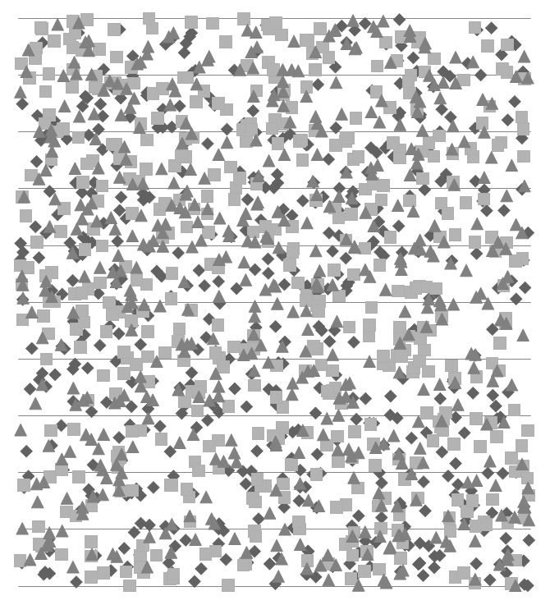









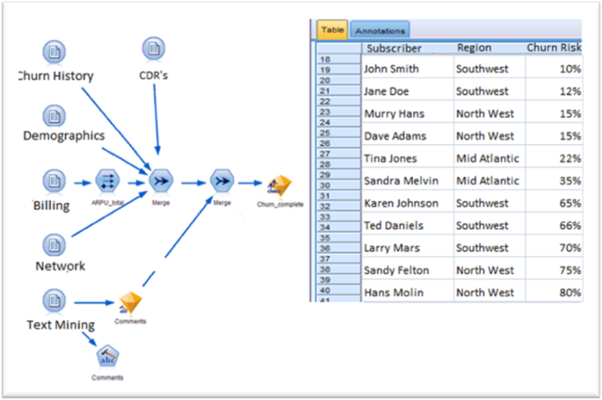


High level Overview of a Data Science led approach to manage churn
Capture & Analyze
Report & Predict
Engage & Act
Predictive
Model
Output
Discover Relationships
Extract Trends
Expose Patterns
Churn
Drivers
Acquisition Data
Tariff & Usage Data
Customer level Data
Recharge data
Monthly Snapshot
Segmented
Targeting
Subscriber
Monitoring
Aggregate
Clean
Transform
Ready to use data
Targeted
Marketing
Actionable
Insights
Customer
Profiles
Business Understanding
Identify data requirements and explore data availability
Request and extract data required to build a model
Aggregate, Clean and Standardize data in desired format for model
Business Analysis of standardized data
Predictive model design
Development and Implementation of Predictive model
List of churn drivers / KPI’s for tracking and monitoring
A generated list of recommended subscribers for targeted churn campaigns
Recommendations on monthly churn initiatives

